Slide 1


OBSTACLE AVOIDANCE ROBOT
SRI RAMAKRISHNA INSTITUTE OF TECHNOLOGY (An Autonomous Institution) Pachapalayam , Perur Chettipalayam , Coimbatore – 641010.
NAME :REZWAN B
CLASS: III B.E-EEE
REG.NO: 71382203018
COURSE CODE:20EEP34
COURSE TITLE:INTRODUCTION TO RASPBERRY PI

Slide 2
OBJECTIVE:
Autonomous Navigation: Move without human intervention.
Obstacle Detection: Identify obstacles using sensors.
Collision Avoidance: Prevent collisions by stopping or changing direction.
Efficient Pathfinding: Choose the best route around obstacles.
Real-Time Processing: Respond quickly to changing environments.
Safety: Operate without damaging itself or its surroundings.

Slide 3
HARDWARE REQUIREMENTS
Raspberry Pi Pico microcontroller(RP20)
Ultrasonic sensor(HC-SR04)
Servo Motor(SG-90)
Dc motor x 2
Motor driver(L298n)
Li-ion Batteries x 2
Connecting Wires
SOFTWARE REQUIREMENTS
Thonny IDE

Slide 4
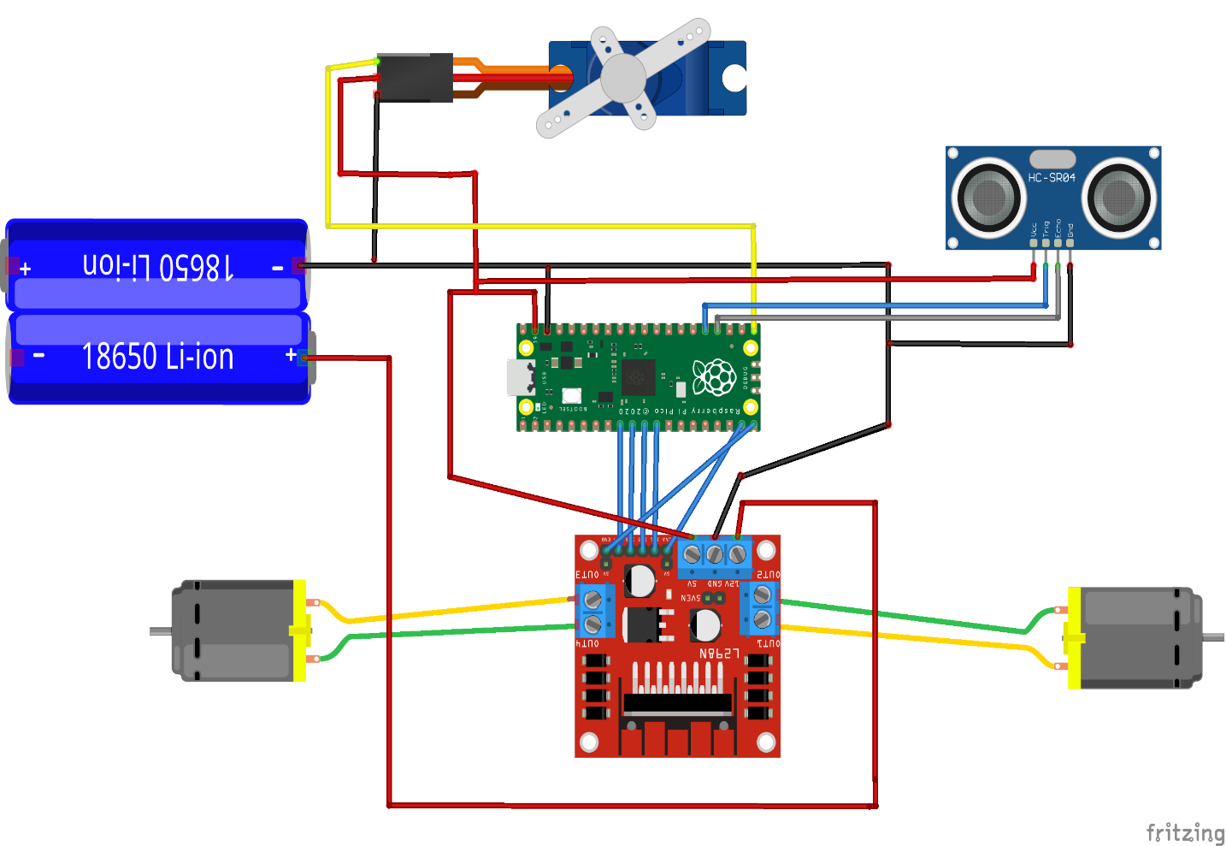
CIRCUIT DIAGRAM:

Slide 5
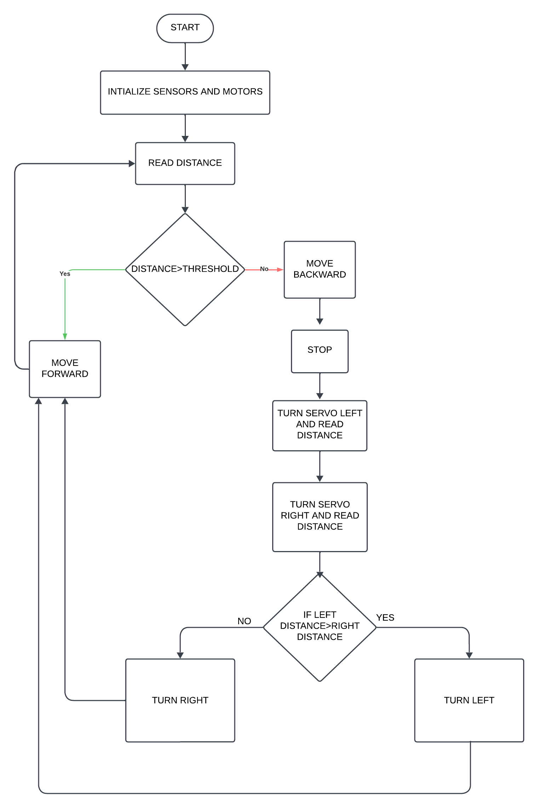
FLOW CHART:

Slide 6
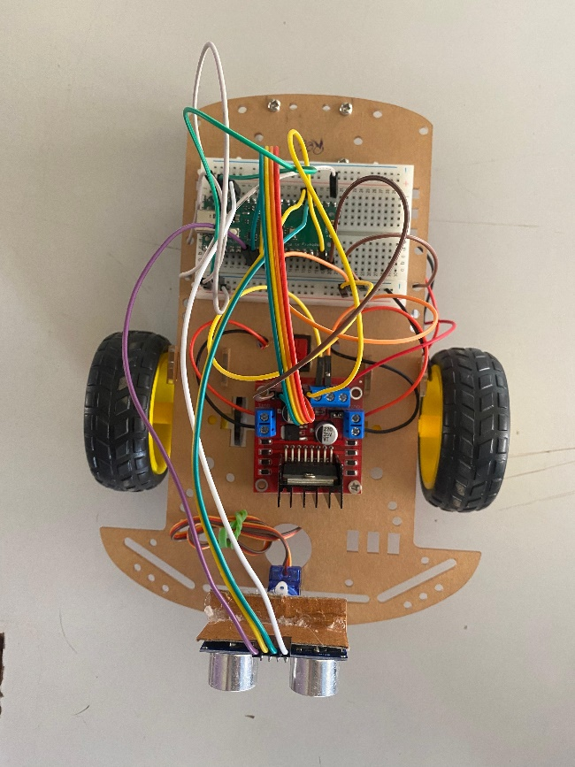
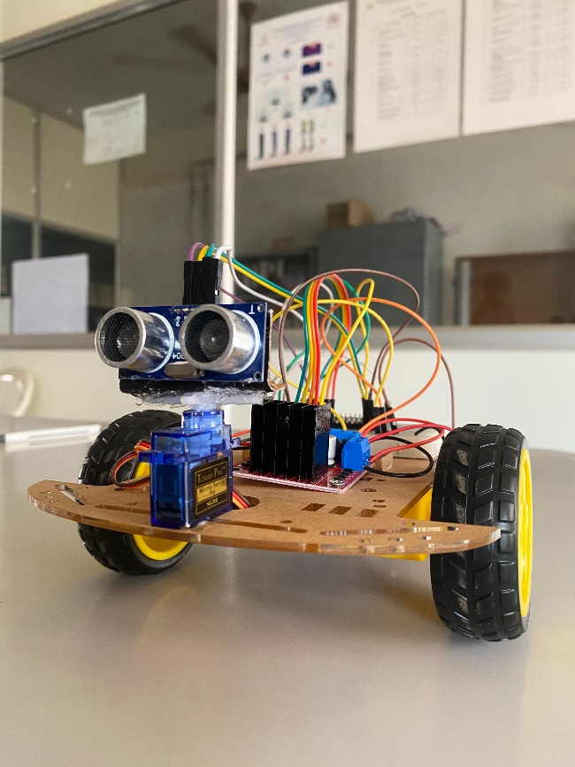
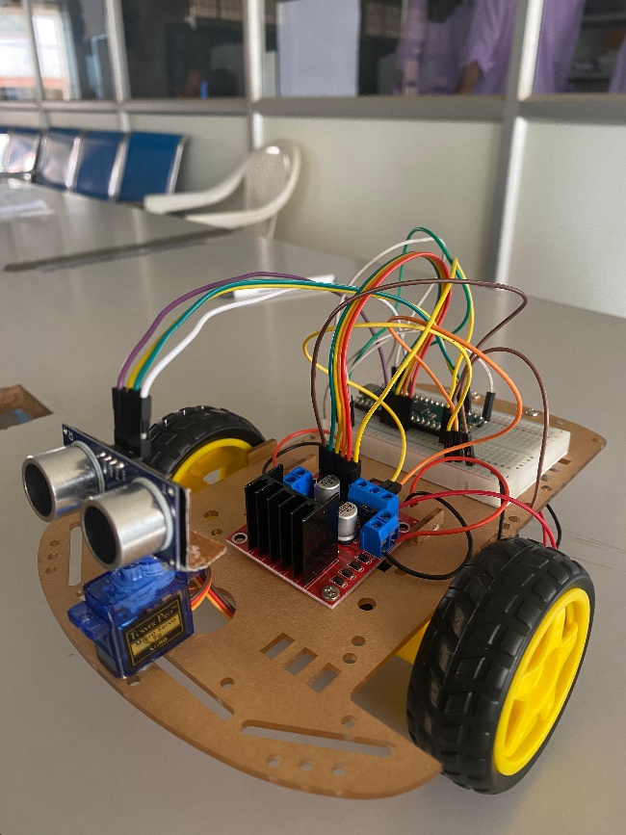
HARDWARE PICTURES

Slide 7
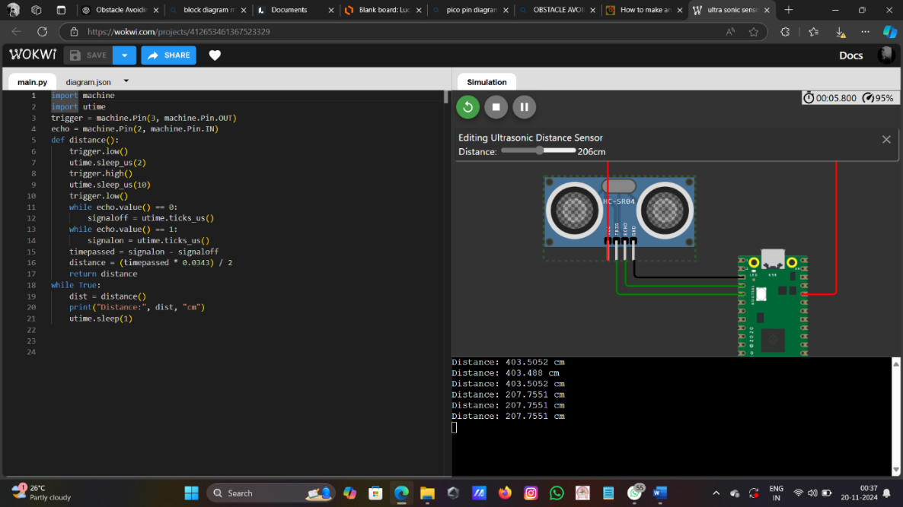
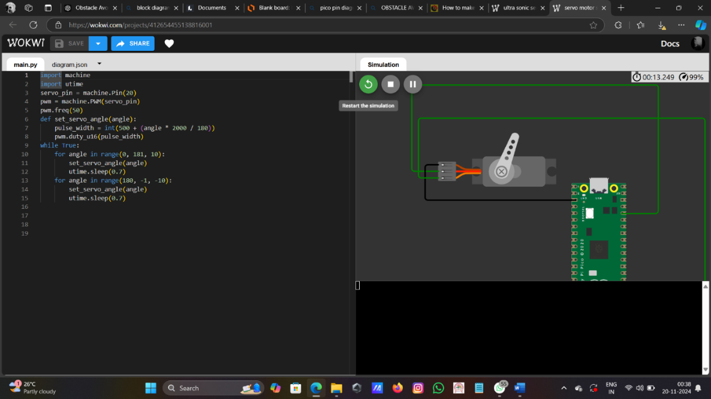
WOKWI SIMULATION
ULTRASONIC SENSOR
SERVO MOTOR
SIMULATION LINK:
SERVO:https://wokwi.com/projects/412654455138816001
ULTRASONIC:https://wokwi.com/projects/412653461367523329

Slide 8
CONCLUSION
The obstacle-avoiding robot successfully demonstrates the integration of sensors, actuators, and control algorithms to achieve autonomous navigation. By utilizing an ultrasonic sensor for real-time obstacle detection, a servo motor for directional scanning, and an L298N motor driver for movement control, the robot efficiently identifies and avoids obstacles. The implemented algorithm ensures smooth operation, allowing the robot to reverse and select the optimal path when faced with obstacles. This project highlights the potential of robotics in automation and sets a foundation for further enhancements, such as improved obstacle detection range, advanced path planning, and multi-sensor integration for complex environments.

